Slide 1

Exploratory Data Analysis
By: Joshua Greenert
Date: 8/9/2022
Class: DSC530-T302

Slide 2


Statistical Question
Are men better at test-taking than women?
Notes:
As the slide shows, our statistical question we’ll be reviewing is whether men are better at test-taking than women.

Slide 3
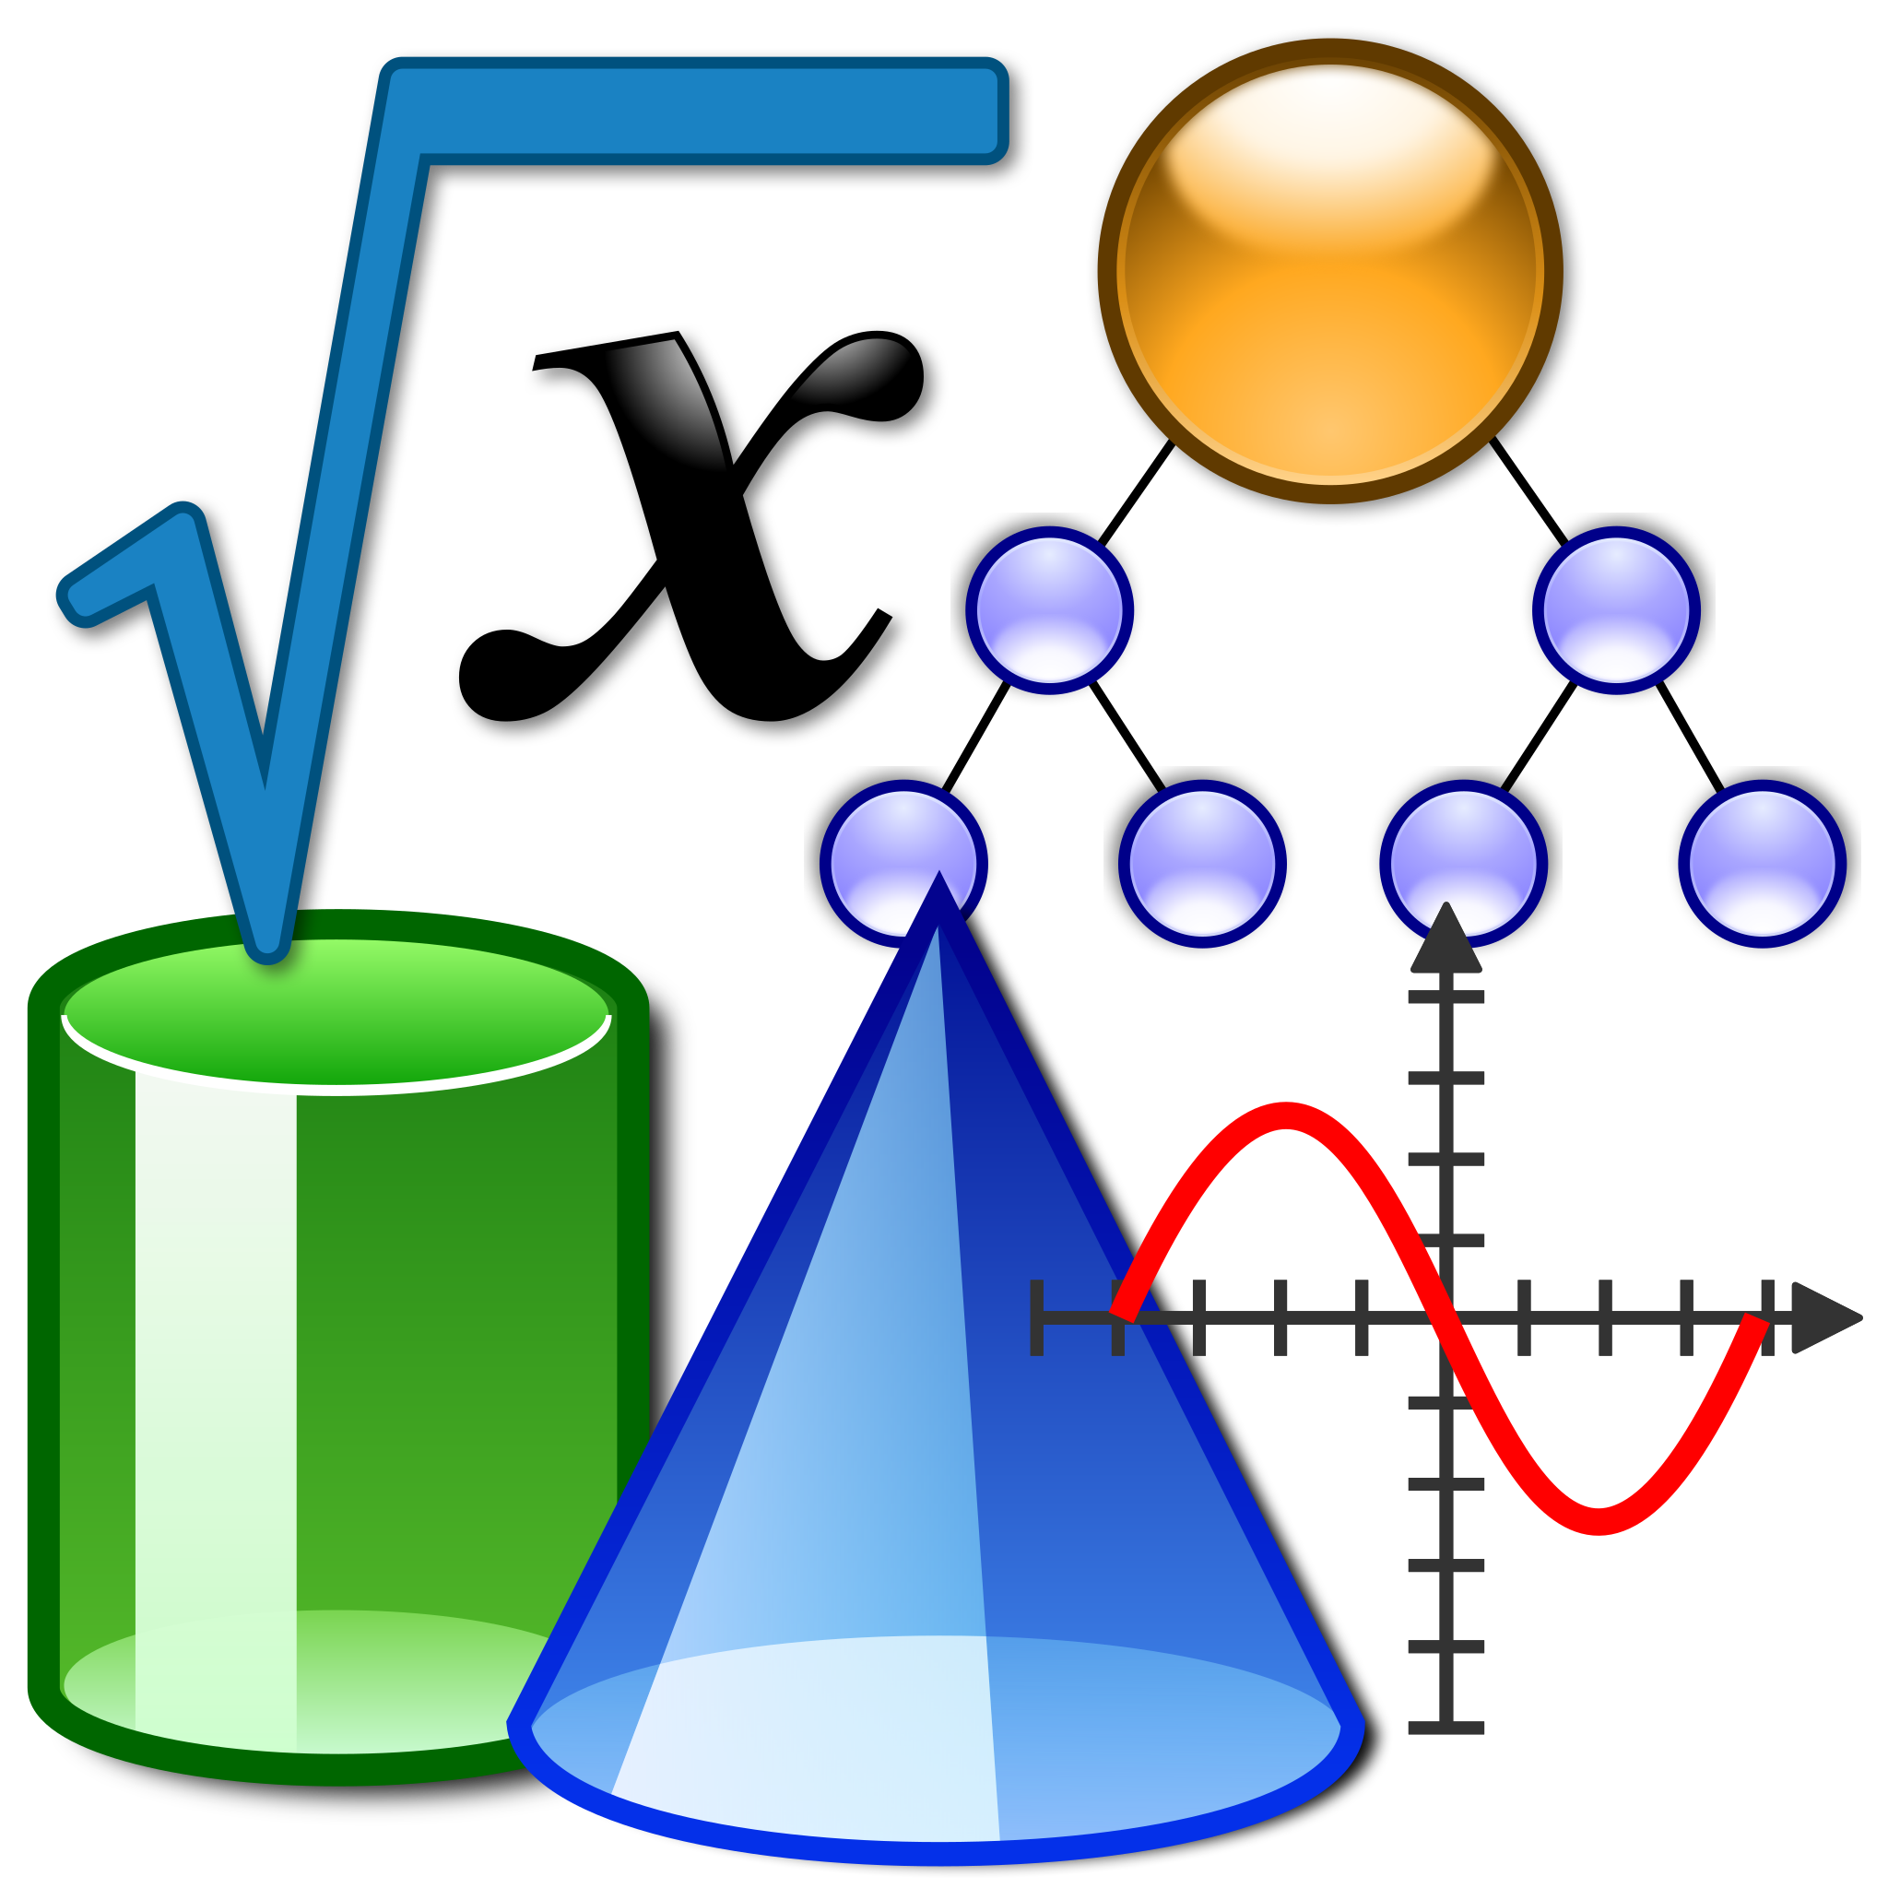
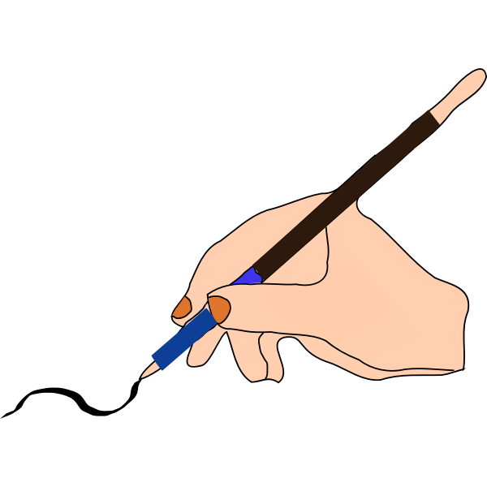
Five Chosen Variables
Math Score
Reading Score
Writing Score
Gender
Parental Level of Education
Notes:
We’ll be looking at the dataset called “StudentsPerformance.csv”. More specifically, we’ll be taking a look at the variables for math, reading, and writing scores while comparing them against gender and their parent’s level of education.

Slide 4
Variable Descriptions
Math Score - Integer representing the score a student received on the math exam
Reading Score - Integer representing the score a student received on the reading exam
Writing Score - Integer representing the score a student received on the writing exam
Gender - The gender of the student (male or female)
Parental Level of Education - Highest level of education completed by the student’s parents
Notes:
Our math, reading, and writing scores are fairly simple to understand. Our final two variables chosen are gender (male or female) and each student’s parent’s respective level of education.

Slide 5
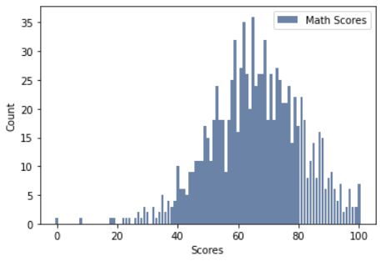
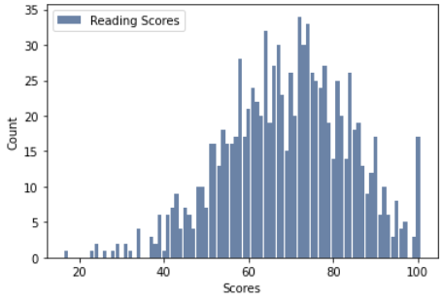
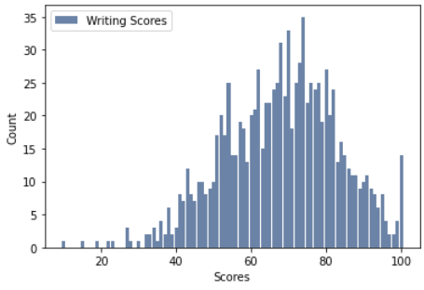
Histograms
Notes:
From the histograms provided over math, reading, and writing, we can see that that there are some noticeable outliers on the far-left side of each graph. However, the overall shape appears like a normal distribution, so the outliers can reflect for what the actual data would show.

Slide 6
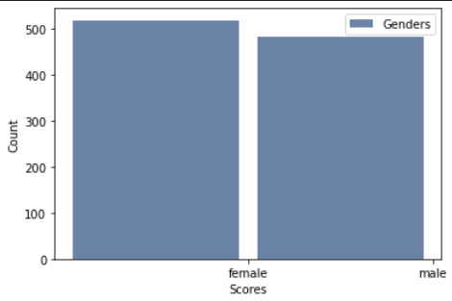
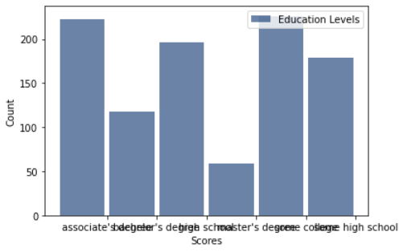
Histograms Continued
Notes:
With the histograms over gender and education levels, there appears to be no outliers. So we can conclude that this data is ready to be further reviewed.

Slide 7
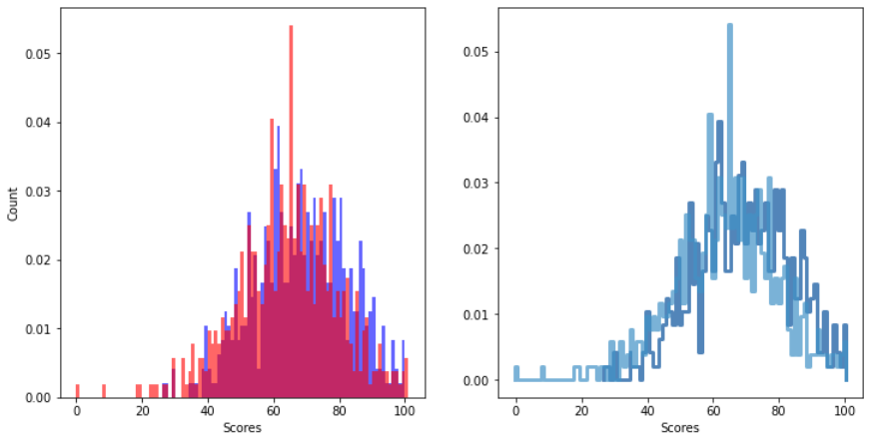
Gender-based Math PMF
Notes:
From the gender based math PMF, we can see that a larger percentage of females scored in the 60 - 80 percent range.

Slide 8
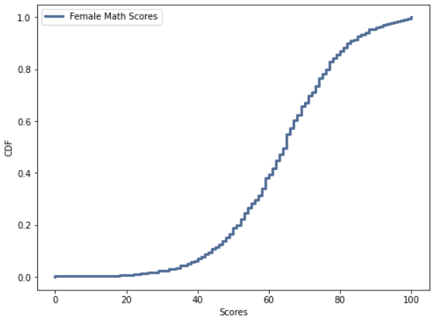
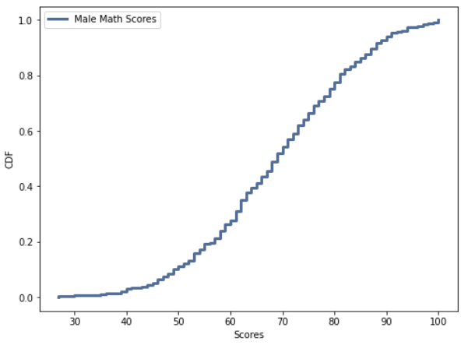
CDF Female Vs. Male
Notes:
From the data represented from the CDF, we can see a trendline where the scores for boys raised sharper than the trendline for the girls. Specifically notable, when the tails are closer to 40 and 50 for the score, this is far more noticeable. However, because these are two separate graphs, it would make more sense to see them placed against one another to note any particular trends that stand out.

Slide 9
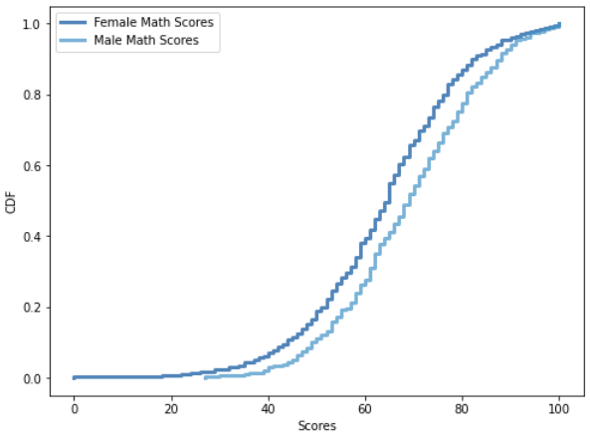
Plot Analysis (CDF)
Notes:
Interestingly enough, the data from the CDFs show that there is a minor gap between the two groups.

Slide 10
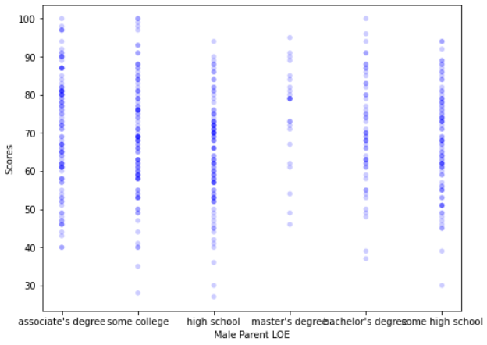
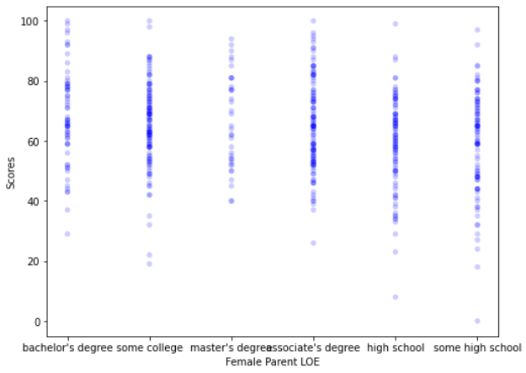
Scatterplots
Notes:
Attempting to compare the scatterplots of each gender’s math scores with their parent’s level of education doesn’t seem to provide anything substantial by itself. Oddly enough, the thinnest line appears to be the student’s whose parents graduated with a master’s degree.

Slide 11
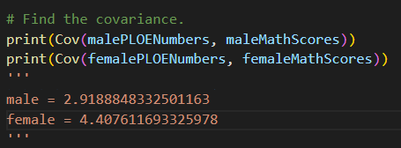
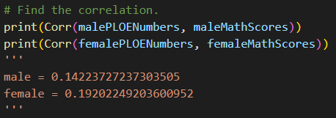
Covariance & Correlation
Notes:
To check the covariance, we can convert the levels of education to numerical data and utilize the covariance function from thinkstats2. According to the data returned, both are positively correlated but hold a weak relationship regarding their parent’s level of education since the numbers are small. Regarding correlation, because the values are less than +- .29, they don’t appear to have a strong correlation either.

Slide 12
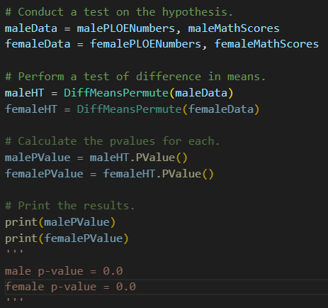
Hypothesis Testing
Notes:
Despite the previous findings, the hypothesis test on the difference of means returns a p-value of 0.0 for both the male and female data. This indicates that the data holds a statistically significant relationship.

Slide 13
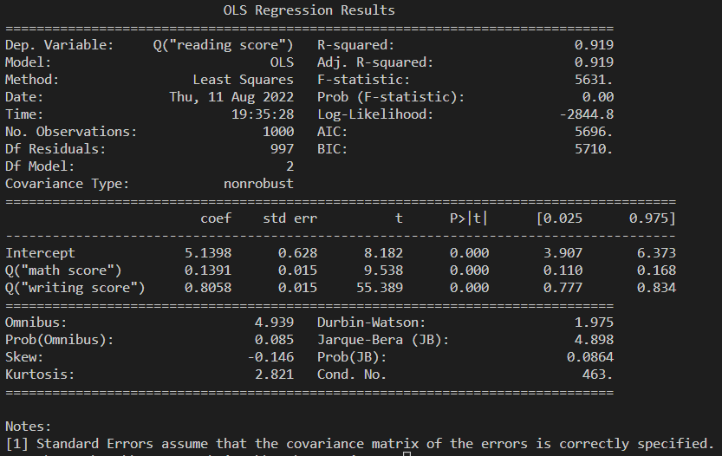
OLS Regression
Notes:
When comparing math scores against reading and writing scores, the f-value is 0. This means that these variables have no predictive capability or dependency on one another. This confirms that the data themselves cannot be dependent on itself within the information.

Slide 14
Conclusion
More Data Needed!
Notes:
From what we have seen within the data, there have been connections between the p-values, but nothing else that indicates any of the variables used are proper predictors to answer our question. In order to obtain a more valuable answer, we’ll need more data to unearth the possibility that this question holds water.

